Slide 1
SharePoint 2007 Administration Tools
Module 3

Slide 2
Agenda
Welcome to Central Administration
Starting with that first SSP
Other admin tools

Slide 3
SharePoint Containment
Farm
Web Front End, APP, SQL
Web Applications
Databases
Site Collections
Sites
Lists
Items
Content, Config, SSP, Search
Central Admin, SSP Admin, Content
Servers
Internet, Intranet Portal, Wikis, Blogs, Team, Doc, Mtg
Wikis, Blogs, Team, Doc, Mtg
Doc Lib, Pages, Events, Discussions, Surveys, etc…
Files, calendar items, contacts, customers, images, custom

Slide 4
MOSS Logical Architecture
Farm – Central Administration
Shared Service Provider
Shared Service Provider
Web Application
Site Collection
Site Collection
Web Application
Site Collection
Sub Sites
Sub Sites
Sub Sites
Web Application
Site Collection
Sub Sites

Slide 5
WSS Logical Architecture
Farm – Central Administration
Web Application
Site Collection
Site Collection
Web Application
Site Collection
Sub Sites
Sub Sites
Sub Sites

Slide 6
Welcome to Central Administration
The site for Administrators to make farm wide settings.

Slide 7
Enabling Services
Based on the servers role you have chosen you will start specific services.
Web, Query, Index, Excel, Etc
Don’t be confused by Server role selection portion. Only a helper.

Slide 8
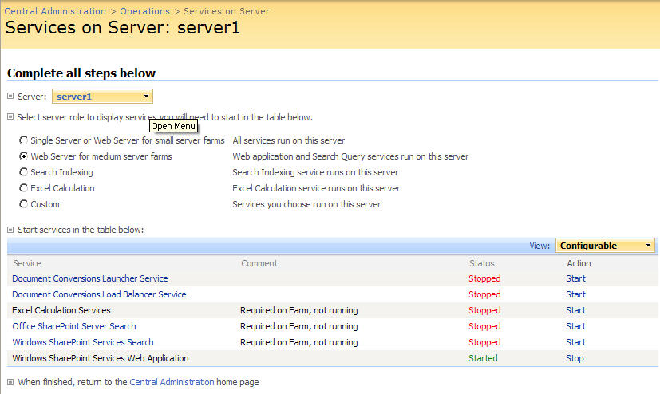
MOSS Services

Slide 9
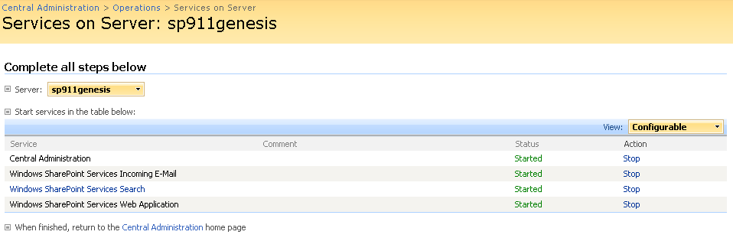
WSS Services

Slide 10
Starting Services
As you hit Start you are taken to configuration screen for service.
Make appropriate settings
Plug in security accounts
Search and Document conversion services correspond to actual server services.

Slide 11
Set Outgoing Email
SharePoint just needs a SMTP server to relay through.
Make sure
Server is setup to allow relay from SharePoint’s IP
No firewall blocking port 25
Antivirus Software not blocking outbound

Slide 12
DEMO!
Tour Central Administration

Slide 13
MOSS Logical Architecture
Farm – Central Administration
Shared Service Provider
Shared Service Provider
Web Application
Site Collection
Site Collection
Web Application
Site Collection
Sub Sites
Sub Sites
Sub Sites
Web Application
Site Collection
Sub Sites

Slide 14
SSP = Reusable Services
The Shared Services Provider (SSP) allows…
Service to be shared across
Web Applications
SharePoint Farms
Think of a parent-child relationship.
MOSS Only Feature
Notes:
What is a Shared Service Provider?
For those of you who don't know what I am talking about a bit of overview. In MOSS 2007 there is this new concept of Shared Services Providers(SSP). The idea being that there are certain services that really make sense to centrally manage and share. A good example being profiles. With a SSP we can import all of the profile information from AD once and then our various web applications can consume the data. So maybe we have http://marketing and http://accounting it doesn't make sense for each one to maintain identical profile information, they should share.
Sometimes the easiest way to think of Shared Services is the Parent vs. Child relationship. The Parent (your SSP) goes out and does all of the work (pulling BDC data, indexing content, hosting My Sites) and the child (your web applications) come to the parents to ask for $5 (request data from the BDC, or view a calculated Excel sheet). Does that help?
Multiple SSPs
One of the most overwhelming things about SSPs for some people planning is how many should I have? It is easy to see from the interface that you are given the opportunity to create more than one. When should you do this?
As a general rule of thumb most companies will use one SSP. This is my default answer. So why do they give you the ability to run multiple SSPs? There are cases where you want separate search or profiles. The most common? Extranet/internet scenarios. Maybe your SharePoint farm hosts two primary web applications. http://portal for your intranet and http://ourcustomers for your extranet. In this scenario you probably want separate search and profiles. And now you have found the reason to have multiple SSPs. You don't want to share information you want unique information for both.
Another advantage of SSPs
Separation of roles. In some medium and large environments it is not uncommon to have one group administering the physical server farm while another group needs to just maintain search. Well the SSP concept makes this very easy. Since the SSP is its own SharePoint site collection you can define a users access so they can NOT access central administration but they CAN access the SSP. And once they get into the SSP you can even limit them. Once inside the SSP you can determine if they can:
Manage user profiles
Manage audiences
Manage permissions
Manage usage analytics
Best I can tell if you give them access to the SSP all of the other SSP functions they will have rights to. Guess it needs more testing.
Still this separation of services from the actual administration of the server can be quite useful. Epically in companies where the less access I give a user the better.
Moral of the story
SSPs are very helpful and important to understand. They should be part of your initial planning. They can be secured at a very granular level or they can be give broad access. Just mark this topic down as something else you need to full think through before you start rolling out SharePoint. And when all else fails just have one SSP.

Slide 15
MOSS Logical Architecture
Farm
Farm
Shared Service Provider
Web Application
Site Collection
Site Collection
Web Application
Site Collection
Sub Sites
Sub Sites
Sub Sites
Sub Sites
Site Collection
Web Application

Slide 16
SSP Components
SSP needs
A web application
Creates Site Collection at http://url/ssp/admin
Creates 2 databases – Search and everything else
Assign SSP to Index server
Service account that it runs as
Location of My Sites

Slide 17
DEMO!
Creating an SSP

Slide 18
Planning number of SSPs
For most companies the right answer is 1
Reason’s not to use 1
Don’t want to share
Intranet vs. Extranet
Security concerns

Slide 19
DEMO!
Tour of the SSP Admin interface

Slide 20
Separation of Powers
Three tiers of administration available
Farm Admins using Central Admin
Role specific admins accessing SSP
Site Collections Administrators taking care of business
All can be mutually exclusive

Slide 21
Other Admin Tools
Stsadm.exe
SharePoint Configuration Wizard

Slide 22
Stsadm.exe
Anything you can do in the GUI stsadm.exe can do better
Located at c:\program files\common files\Microsoft shared\web server extensions\12\bin
Has 184 different options available
Backup/restore, Import/export, create sites, add web parts, execute timer jobs, and 177 other things
Extensible – Add your own functionality

Slide 23
DEMO!
Can’t talk about the coolest tool on the block without showing it off.

Slide 24
SharePoint Configuration Wizard
GUI available from the Start menu
Allows you to
Detach/reattach a server to a farm
Allows you to change what server hosts central admin
Also available in command line form
Psconfig.exe in same directory as stsadm.exe
Will stop IIS Web Services so be careful when you run this
Most admins forget about this tool. Crucial when fixing major screw ups. ☺

Slide 25
Databases
SharePoint_Config
SharePoint_AdminContent_{GUID}
WSS_Search_Litwareserver
WSS_Content_SSP
Primary_SSP_DB
Primary_SSP_Search_DB
WSS_Content_MY

Slide 26
Farm wide security
Farm administrators group for central admin
Does not give you full access to all sites
Need full access to all sites
Policy for web application
Full Control
Full Read
Deny Write
Deny All

Slide 27
A note on My Sites
Choose their host location wisely
Same Web app as your SSP
Their own Web app
Same Web app as your portal

